Slide 1
MAHARISHI INTERNATIONAL UNIVERSITY
1971-1995
MAHARISHI UNIVERSITY
of
MANAGEMENT
Engaging the Managing
Intelligence of Nature

Slide 2
Advanced Software Development
CS Faculty
Computer Science Department

Slide 3
Lesson 9:
Introduction to Frameworks

Slide 4
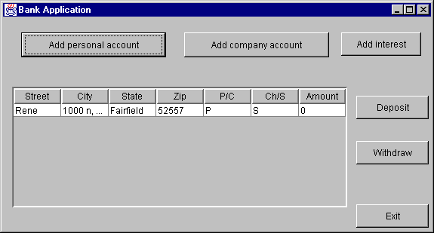
Homework
Design the complete class diagram for a banking application with the following use cases:
    Create a personal account (checking or saving)
    Create a company account (checking or saving)
    Deposit money
    Withdraw money
    Add interest

Slide 5
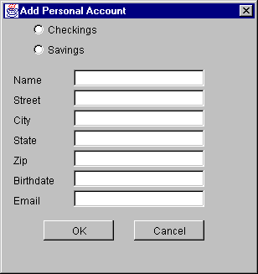
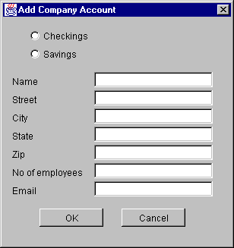
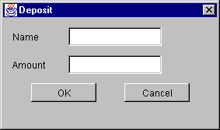
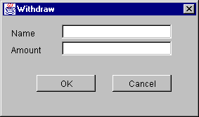

Slide 6
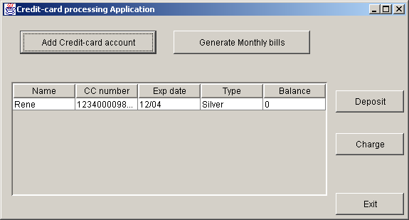
Homework
Design the complete class diagram for a credit-card processing system with the following use cases:
    Create a credit card account
    Deposit money to the credit card account
    Charge the credit card account
    Generate monthly billing

Slide 7
